Slide 1
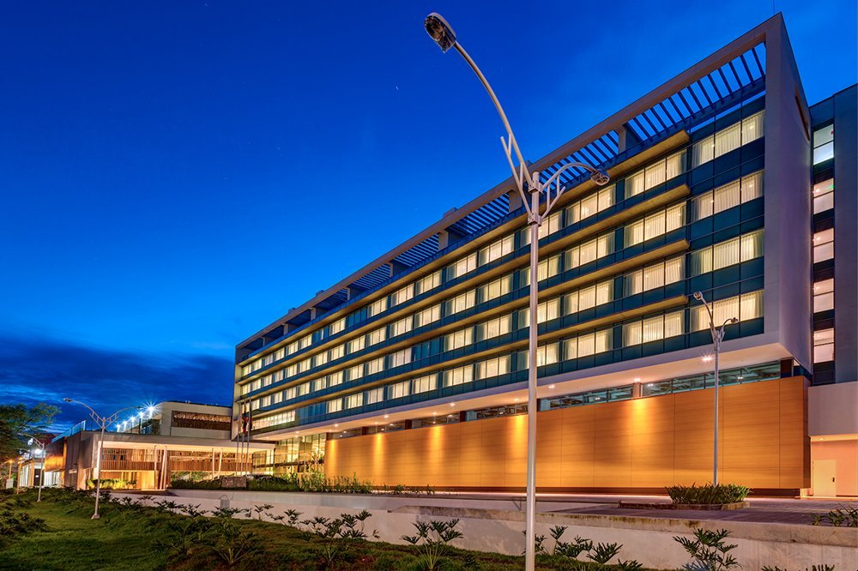

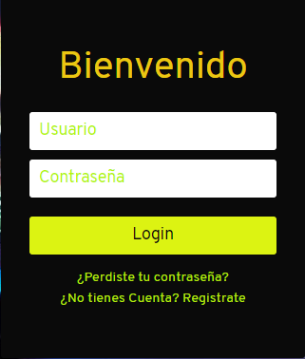
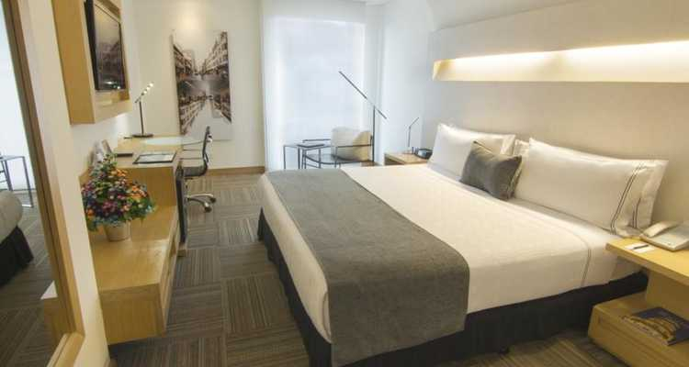
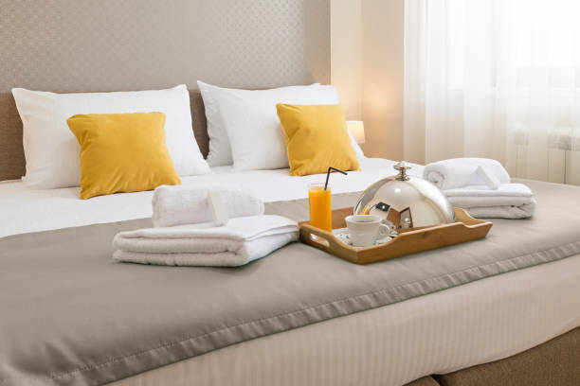
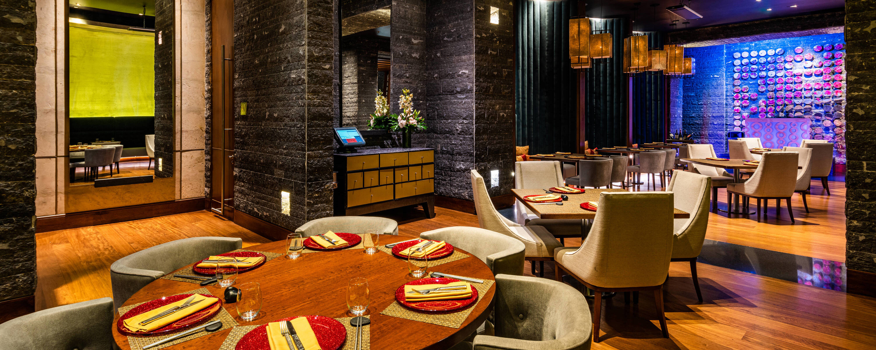
AUTENTICACIÓN
RESERVAS
REGISTRO
REPORTES
Five Stars Hotel, Restaurant & Bar
This luxury hotel is located on Bocagrande Beach, Cartagena's most important tourist and commercial area, and offers 4 dining options, a casino, a pool with sea views, and free Wi-Fi. It also has function rooms and meeting facilities.

Slide 2
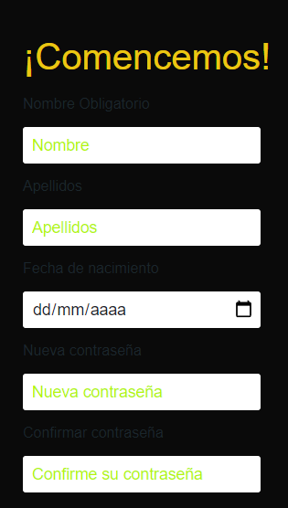
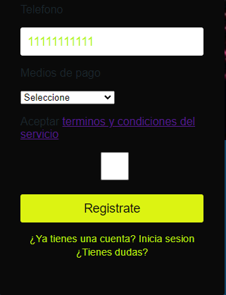
AUTENTICACIÓN
RESERVAS
REGISTRO
REPORTES
Five Stars Hotel, Restaurant & Bar
This luxury hotel is located on Bocagrande Beach, Cartagena's most important tourist and commercial area, and offers 4 dining options, a casino, a pool with sea views, and free Wi-Fi. It also has function rooms and meeting facilities.

Slide 3
REGISTRO DE INGRESOS
Número de Reserva
Número de Habitación
Documento
Nombre Completo
Five Stars Hotel, Restaurant & Bar
Email
Celular
Check-in dd/mm/aaaa
Check-Out dd/mm/aaaa
Número Adultos
Número Niños
Registro de Acompañantes
Número de Tarjeta de Crédito
REGISTRAR
This luxury hotel is located on Bocagrande Beach, Cartagena's most important tourist and commercial area, and offers 4 dining options, a casino, a pool with sea views, and free Wi-Fi. It also has function rooms and meeting facilities.

Slide 4
CONSULTA RESERVAS
Five Stars Hotel, Restaurant & Bar
dd/mm/aaaa
Buscar
Registro de Acompañantes
This luxury hotel is located on Bocagrande Beach, Cartagena's most important tourist and commercial area, and offers 4 dining options, a casino, a pool with sea views, and free Wi-Fi. It also has function rooms and meeting facilities.

